Slide 1
Analyzing Amazon Product Trends
Rutgers University Data Science Bootcamp – Project 1 Presentation
Tasnuva Airen, Will Giordano, Mostafa Moamen, Matthew Richtmyer
January 14, 2020

Slide 2

Project Introduction: Analyze trends from Amazon Product Data
Goals:
Explore Amazon product reviews and trends over time
Describe common product features which could be improved
So what?
Market research allows us to understand the consumer better, map new trends, strategies, communications, new product development, etc.

Slide 3
Project Workflow
Acquisition
Cleaning
Analysis
Language Modeling

Slide 4

Data Acquisition
~34k consumer reviews of Amazon Products containing information like:
Products (e.g. Echo, Fire Tablets)
Reviews / Review Titles / Ratings
Date Reviewed
Category and Business Units
Recommended
Three csv files
Kaggle Competition:
https://www.kaggle.com/datafiniti/consumer-reviews-of-amazon-products

Slide 5

Data Cleaning
Process
Combining three csv files
Reformat all files to have same columns and datatypes. Perform concatenation
Reformat all data
Timestamps were partially corrupted
Simplify product names
Final touches
Drop NaNs, reset index, delete duplicates

Slide 6
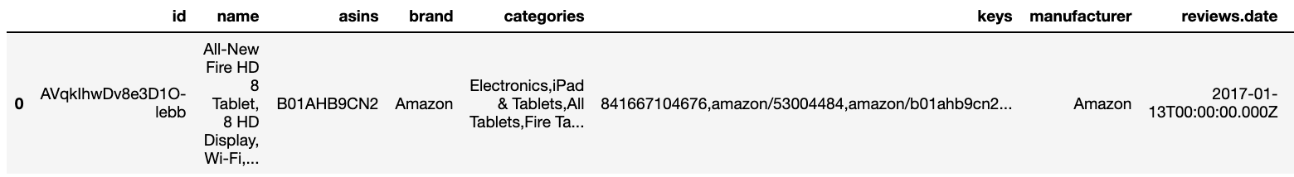
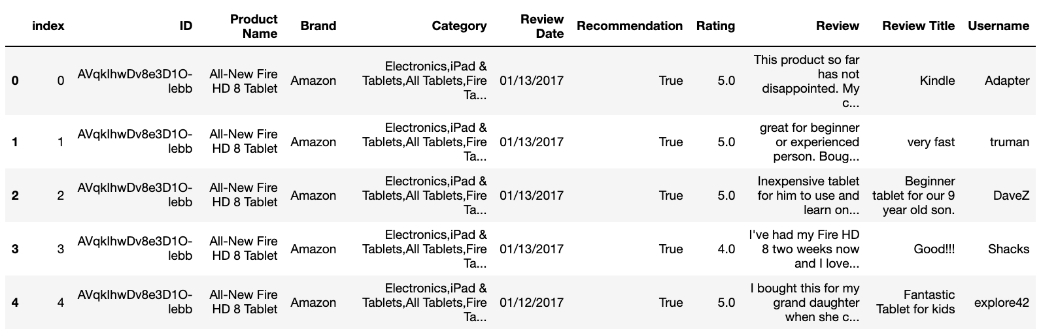
Before:
After:
Highlights:
Convenience: Only retaining useful columns, all columns have higher readability with correct formatting
Consistency: Removed erroneous data, same datatypes within columns

Slide 7


Data Analysis
Process
Explore trends in dataset
Frequency of each category of rating
Mean ratings of top products
Recommendation distribution
Business unit performance
Temporal trends with products and reviews

Slide 8
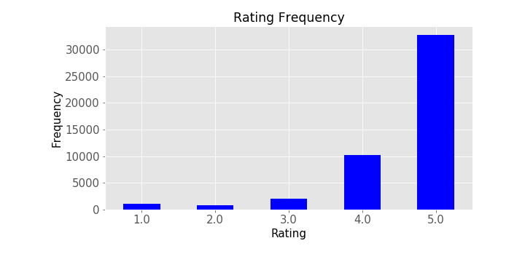
Trends with Product Ratings
Figure 1: Distribution of ratings for all products in dataset. Approx. 95% of all reviews are >4 stars
Figure 2: Average product review for top 20 products. Highest rated product is the Fire HD 8 Tablet with Alexa functionality.

Slide 9
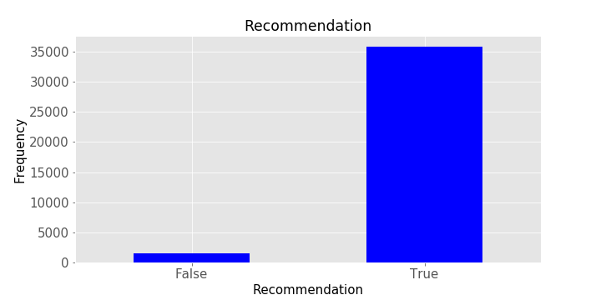
Trends with Product Ratings
HOLD: Align on figures
Right: color scheme? x/y labels switched
Figure 3: Distribution of recommendation. Largely, everyone was pleased with their products and would recommend to others.
Figure 4: Distribution of ratings across distinct Amazon Platforms (e.g. Echo, Fire, and Basics). Basics has significantly more ratings (and likely purchases) which could correspond to lower price points.

Slide 10
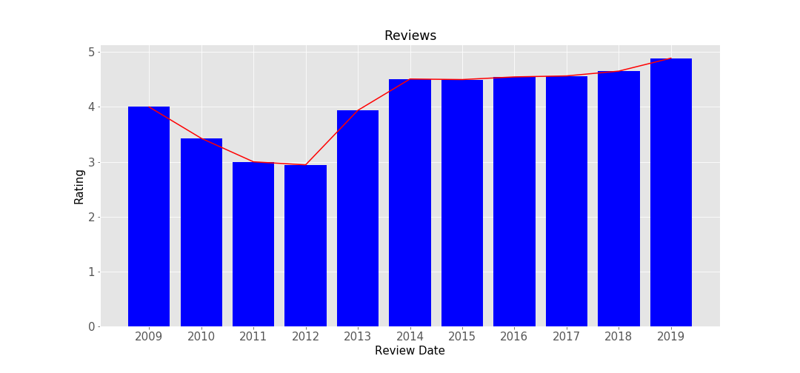
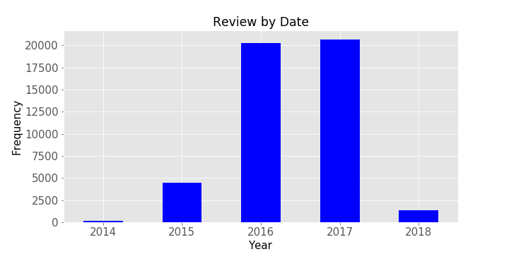
Temporal Trends with Ratings
HOLD: Align on figures
Left: color scheme? y label cut off. No x label? Title?
Right: title, x/y label, x/y ticks font size too small. Trend line? Color scheme? Same time frame as left?
Figure 5: Distribution of number of reviews per year. Interestingly, reviews were low in 2014, 2015 and 2018 likely due to issues in acquisition
Figure 6: Mean ratings per year. Generally, ratings have increased since 2012.

Slide 11
Overview: Topic Modeling
Form of text mining that can analyze large quantities of text data and look for underlying patterns
Unsupervised machine learning – do not know labels a priori
Pre-processing
Language Model
Topic Model
Tokenize
Lemmatize
Bigram
Latent Dirichlet Allocation (LDA)
Stop words

Slide 12

Intuition behind LDA Topic Modelling
Word distributions teach inform understanding of topics
Topic distributions teach context clues
Each Document has a distribution of Topics and each Topic has a distribution of Words
Notes:
M denotes the number of documents
N is number of words in a given document (document i has {\displaystyle N_{i}} words)
α is the parameter of the Dirichlet prior on the per-document topic distributions
β is the parameter of the Dirichlet prior on the per-topic word distribution
Theta is the topic distribution for document I
Phi is the word distribution for topic k
Z is the topic for the j-th word in document I
W ij is the specific word.

Slide 13
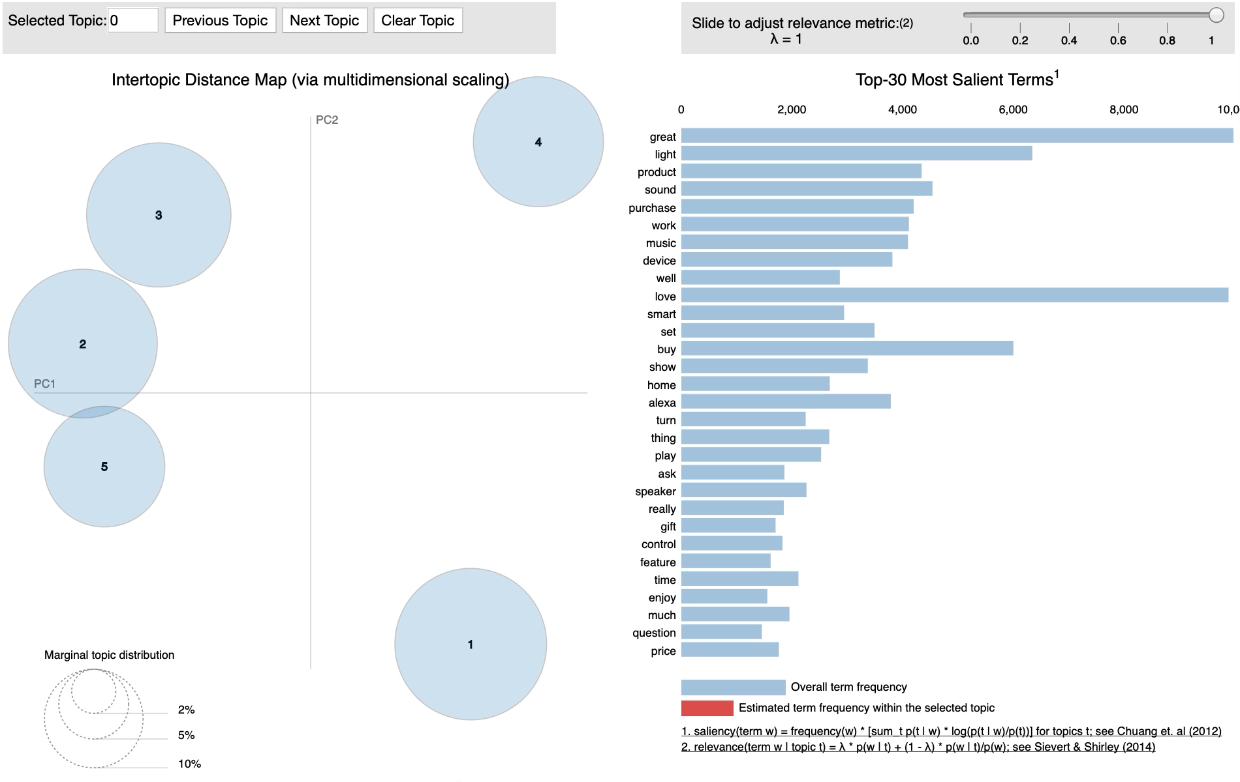
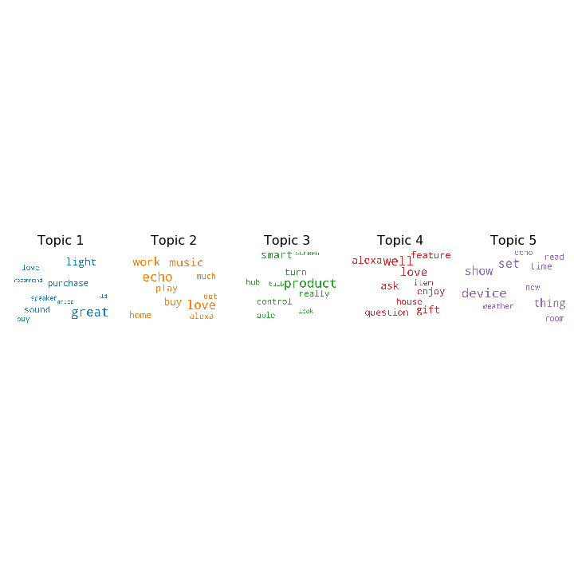
Results: LDA Topic Model
HOLD: Align on figures
Words not readable in histogram
Font size too small on wordclouds?
Language Model: Spacy
Implementation: Gensim Visualization: pyLDAvis and WordCloud
Four distinct clusters emerge from training ~30k reviews
Topics with darker background looked more readable
A
Figure 7: Panel A. LDA topic model plotted on two main principle components. Term frequency and document frequency distributions provided per cluster (right). Panel B. Word clouds corresponding to topics modeled.
B

Slide 14
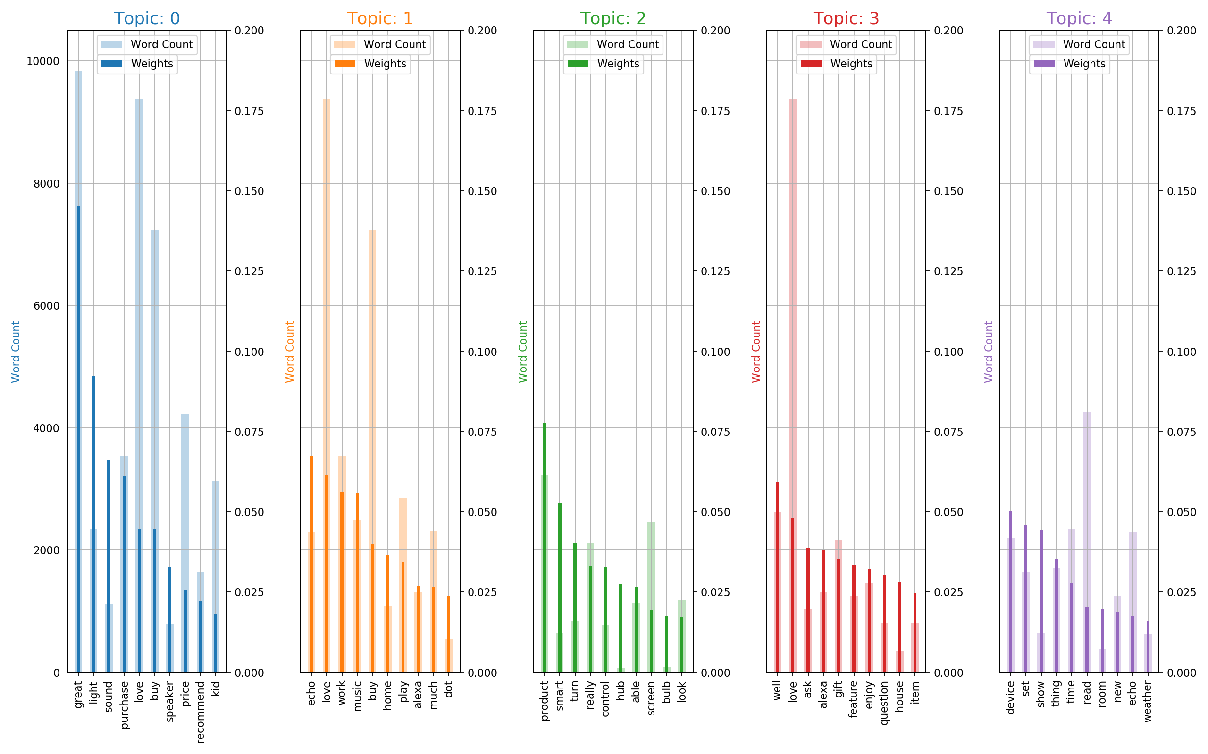
LDA Weights Don’t Always Trend with Document Term Frequency
HOLD: Align on figures
X label?
Figure 8: Word term frequency and corresponding model weights graphed for top ten weights. Notice that often highest frequency words are not sensitive features for topic models.

Slide 15
Conclusions
Most people seem satisfied with products for the past 5 years
Largely only four- and five-star reviews are given
Top products with highest mean ratings are Fire Tablets and Kindles
Topic model shows ~3 distinct topics which could be:
User interface, user experience and product features.
Unsupervised learning model – have to make best interpretation

Slide 16
Thank you!
Questions?

Slide 18
Backup Slides

Slide 19
LDA Topic Modeling

Slide 20
Pre-processing
Tokenization:
Lemmatization:
Code
Coding
Codes
Coded
Common root: “code”
Figure Adapted from:
https://medium.com/@makcedward/nlp-pipeline-word-tokenization-part-1-4b2b547e6a3

Slide 21
Language Models
Bag of words
Simpler model, but destroys sequence info
N-gram models
Bigram looks at sequences of 2 words from pre-processed text
Figure Adapted from:
https://towardsdatascience.com/word-bags-vs-word-sequences-for-text-classification-e0222c21d2ec

Slide 22
Latent Dirichlet Allocation

